Slide 1
Learning from Data
3rd Sep 2019

Slide 2


Slide 3
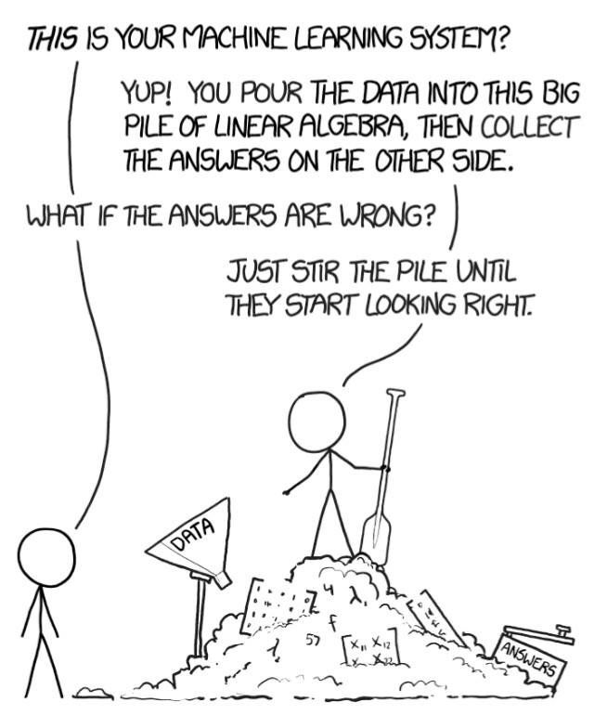

Slide 4
Missing something ..??

Slide 5
Spanish Lottery

Slide 7
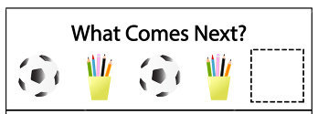
Toy Problem 1
Infer a rule through instances…….
This is a typical “Prediction” Problem

Slide 8
Toy Problem 2
Infer a rule through instances…….
This is a typical “Regression” Problem

Slide 9


Toy Problem 3
Training samples : Tuple (Pattern, class label)
Class 1
Class 2
Infer a rule through instances…….
What about this ????
This is a typical “Classification” Problem
Test sample : Only pattern is given
We need to complete the Tuple (Pattern, ??class label??)

Slide 10
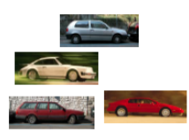

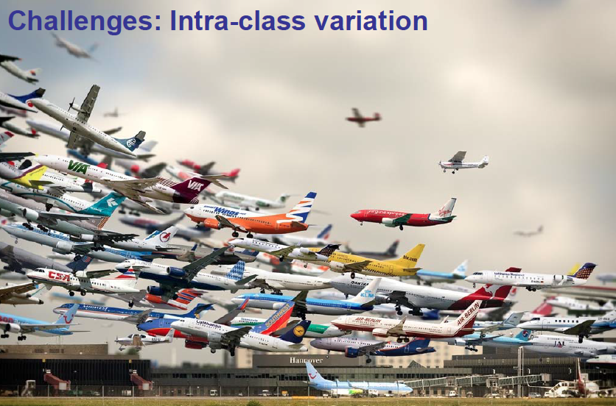
Extending the problem
Training samples : Tuple (Pattern, class label)
Label = CAR
Label = ??
Test sample : Only pattern is given
We need to complete the Tuple (Pattern, ??class label??)
Label = PLANE
Label = ??
Training samples : Tuple (Pattern, class label)

Slide 11
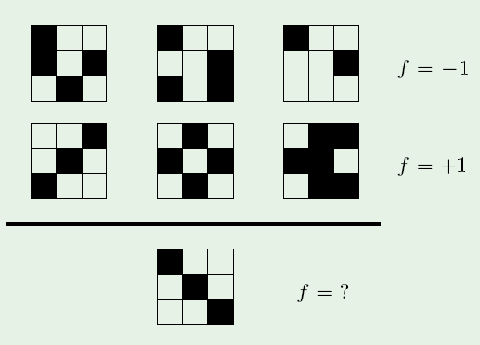
Classification (From Prof. Mostafa’s slides)

Slide 12
Essence of Learning (From Prof. Mostafa’s slides)
There has to be a pattern
Pattern may/may not be captured in a mathematical expression
We should have data on it

Slide 13
Essence of Learning (From Prof. Mostafa’s slides)
There has to be a pattern
Pattern may/may not be captured in a mathematical expression
We should have data on it
Seeking a process that can capture the underlying pattern, without we needing to explicitly spell it out : Learning from Data

Slide 14
Questions
What is Learning ?
Can we Learn ?
How to Learn ?
How to Evaluate Learning ?
How to Learn well ?
Is there a situation when we cannot Learn ?

Slide 15
Components

Slide 16
Supervised Learning

Slide 17
UnSupervised Learning

Slide 18
MNIST Data Set

Slide 19
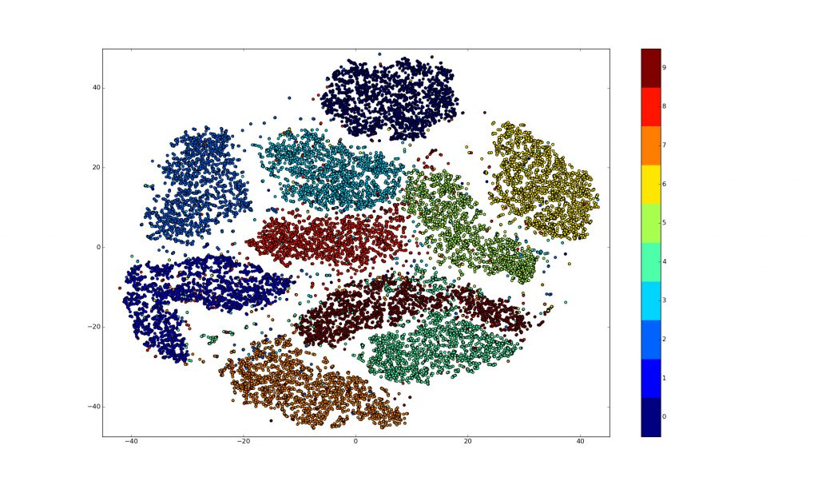
tSNE Visualization
Different colours refer to Different Digits 0 through 9 !!

Slide 20
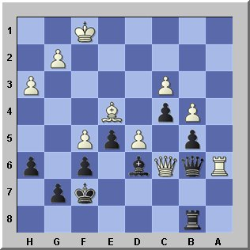
Reinforcement Learning
On 10 February 1996, Deep Blue became the first machine to win a chess game against a reigning world champion (Gary Kasparov)

Slide 22
When is it ML – When NOT ?
Movie Recommendations !!

Slide 23
When is it ML – When NOT ?

Slide 24
Learning Components

Slide 25
Learning Components

Slide 26
Learning Components

Slide 27
Solution

Slide 29
Model is learnt – Using finite number of Observations
But
Expected to work well on all varieties of unseen Data

Slide 30
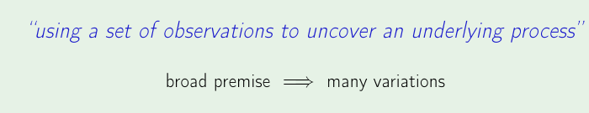
Basic Learning Premise
Training samples are drawn Independently of each other
All Training samples come from the same underlying process
Training Samples are all Independent Identically Distributed (IID) Samples

Slide 31
PAC Learning

Slide 32
BIN - Expt
Finite Training Samples
Interpret : BIN = Domain from which Data comes (Infinite)
MARBLE = Specific Data sample
Need to infer about the Distribution of Marbles in the bin, using the Sample observed

Slide 33
BIN - Expt

Slide 38
M is the Growth function of the Hypothesis Set
Learning possible only if, “M is a polynomial in “N”
Why…????
If a Hypothesis class has a Polynomial Growth function, then Learning is Possible

Slide 39
When Is Learning Not possible ?

Slide 40
2 aspects of Learning
Behaviour on Training Data should resemble behaviour on Test Data –
Also called ???
Error on Test Data should be Small – Also called ???

Slide 41
What does Hoeffding Inequality tell ?

Slide 42
From Data ----->To Features
Class 1
Sample 1
Sample 2
Sample 3
Class 2
Sample 4
Sample 5
Sample 6
Let’s Define Feature as, = Number of Black boxes
Number of black boxes
2
1
1
2
3
4
5
6
Training Sample Number

Slide 43
Feature space
Feature extractor : Mapping from Data to Feature Space
Feature Extractor : Data -> (Feature1,Feature2,..)
What is the advantage ?
In this case, if the image is of size 10 X 100, we need 1000 pixels to represent every Data point
But using Feature Extraction, each Data point is now represented by only one Integer
Features should get us closer towards discovering inherent patterns

Slide 44
From Data ----->To Features
Class 1
Sample 1
Sample 2
Sample 3
Class 2
Sample 4
Sample 5
Sample 6
Let’s Define Feature as, = Number of Black boxes
Number of black boxes
2
1
1
2
3
4
5
6
Training Sample Number

Slide 45
Feature space
Extract “good” Features from the Given Data
Each Sample instance is mapped to a point in the Feature-space
Sample Instance = {Feature1, Feature2, Feature3,….}
For an unseen test sample, what do we do ?
Compute number of black boxes
If 1, then Class 2
If 2, then Class 1
Number of black boxes
2
1
1
2
3
4
5
6
Training Sample Number

Slide 46
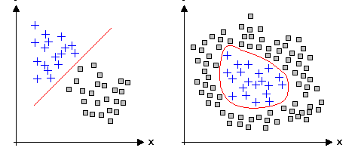
Data separability in Feature-space
Feature2
Feature2
Feature1
Feature1
Linearly separable
Non-Linearly separable
Which kind of data is easier to work with ??

Slide 47
MNIST Data

Slide 48
Feature Extraction

Slide 49
Feature Space

Slide 50
Linear Boundary

Slide 51
Important Notions
Dichotomies :
Growth Function :
Notion of “Shattering the Data”
VC Dimension :
Learnability :

Slide 52
Quantifying Expressive-ness in Hypothesis
How Many Distinct Hypotheses are possible ??
Infinite !!!
Smarter way of counting different possibilities ??
Dichotomies

Slide 53
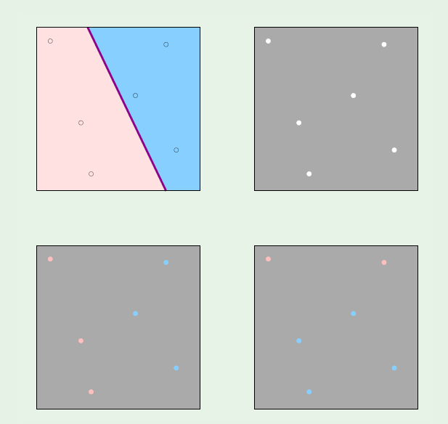
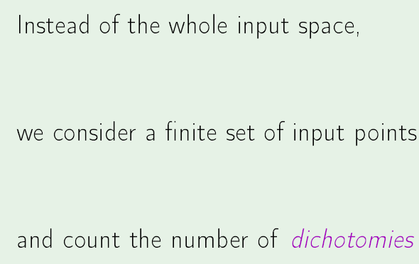
Hypothesis - Dichotomies

Slide 54
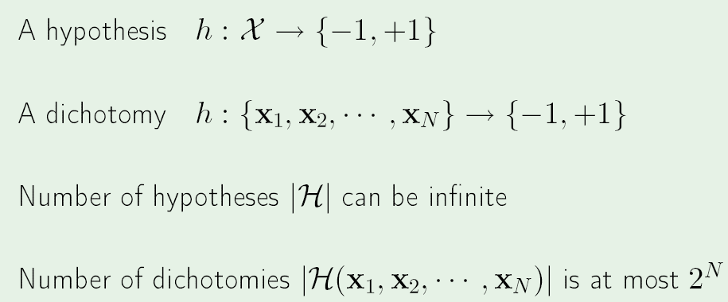
Dichotomies

Slide 55
Important Notions
Dichotomies :
Growth Function :
Notion of “Shattering the Data”
VC Dimension :
Learnability :

Slide 56
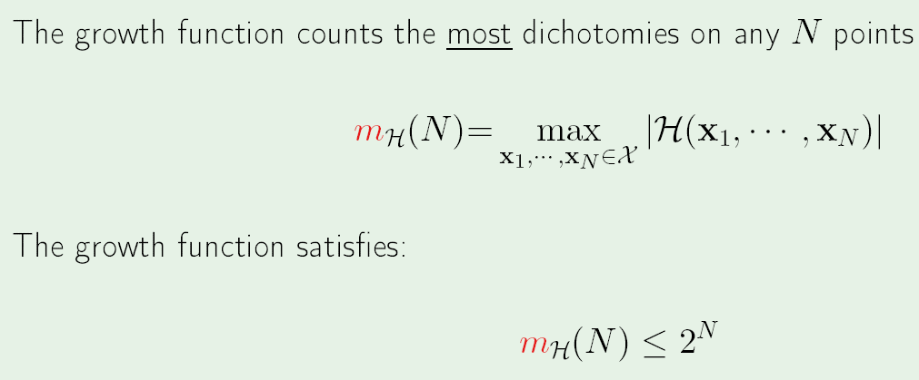
Growth Function

Slide 57
Growth Function
Simple Hypothesis : Fewer Dichotomies
Small Growth Function
Complex Hypothesis : More Dichotomies
Large Growth Function

Slide 58
Break Point
The number “k”, of data points, for which NOT all possible classifications can be achieved
Eg. N = 3, k = 2 .
Possible classifications are
000, 001,010, 011 X, 100 , 101 X, 110 X, 111 X

Slide 59
Important Notions
Dichotomies :
Growth Function :
Notion of “Shattering the Data”
VC Dimension :
Learnability :

Slide 60
Shattering a Data set
Given a constellation of N points, placed in whichever way, Classify into all possible ways..

Slide 61
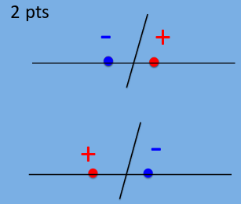
Shattering a Data set
Classify “N” points using a 2D linear boundary, into all possible ways..
N = 2 : ++, +-, -+, --

Slide 62
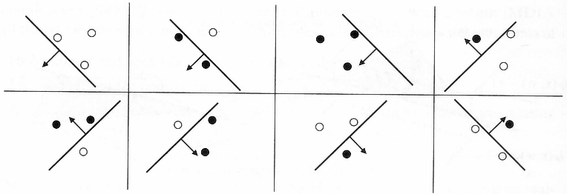
Shattering a Data set
N= 3 (possible labels +++, ++-,… ) and a 2D linear boundary

Slide 63
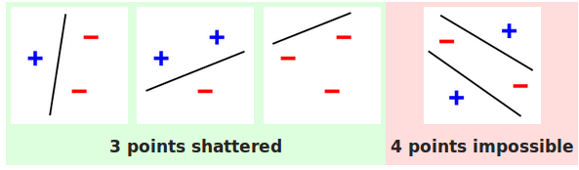
Shattering a Data set
For a 2D perceptron, break-point, k = 4
For a d-D perceptron, break-point, k = d+2

Slide 64
Shattering a Data Set
To shatter a configuration of points, the classifier must be able to :
For every possible assignment of positive and negative for the points, perfectly partition the plane such that the positive points are separated from the negative points.
For a configuration of N points, there are 2^{N} possible assignments of positive or negative, so the classifier must be able to properly separate the points in each of these.

Slide 65
Important Notions
Dichotomies :
Growth Function :
Notion of “Shattering the Data”
VC Dimension :
Learnability :

Slide 66
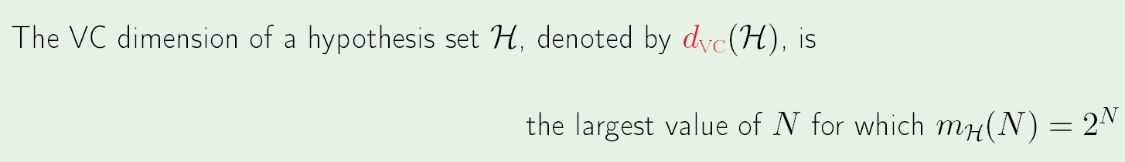
VC Dimension
Expressive power of the Hypothesis
The VC dimension of a class H is the largest “N”, such that the value of Growth function = 2^{N}
Min Break_point = VC_dimension + 1 (These measures are, Specific to a Hypothesis Set)
For a Linear Classifier in “d” dimensions : VC_Dim = d + 1

Slide 67
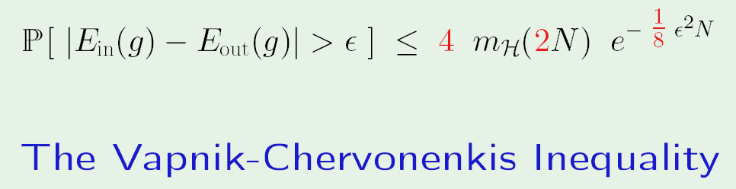
Hoeffding to VC Inequality
m_{H}(U) = Polynomial in U, if VC_Dim = Finite Quantity
Hence, Finite value for VC_Dim implies PAC Learning possible

Slide 68
Important Notions
Dichotomies :
Growth Function :
Notion of “Shattering the Data”
VC Dimension :
Learnability :

